Slide 1
Scott's Petshop
An application by Scott Nicolson

Slide 2
"To create a CRUD application with utilisation of supporting tools, methodologies and technologies that encapsulate all core modules covered during training."
BRIEF

Slide 3
Intro
Planning
Application
Front End + Back End
h2 Server
Testing
GitHub
Supporting Software
Issues
To achieve my goal:
I have decided to create a Petshop application.
The user will be able to fill out the form on my designed Front End that creates a card.
This card will display all of the information on the pet they wish to advertise.

Slide 4
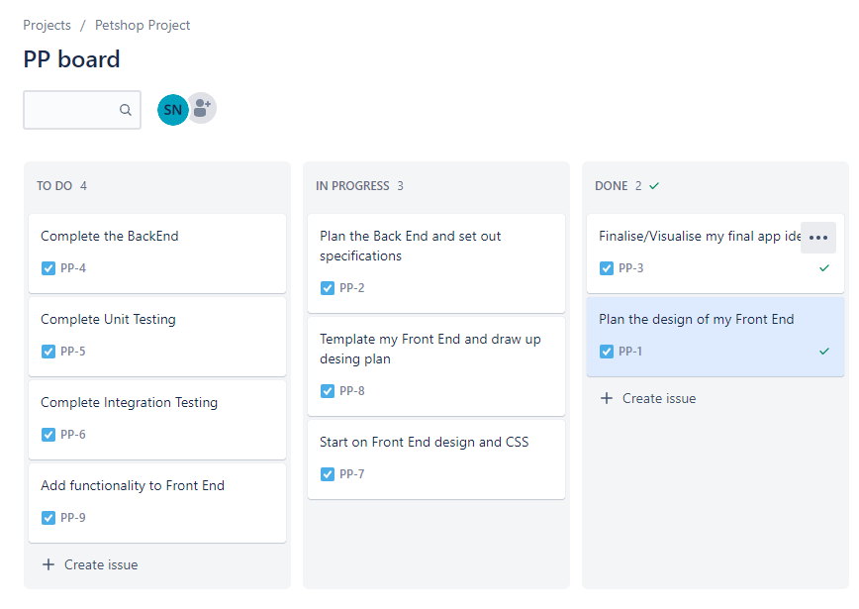
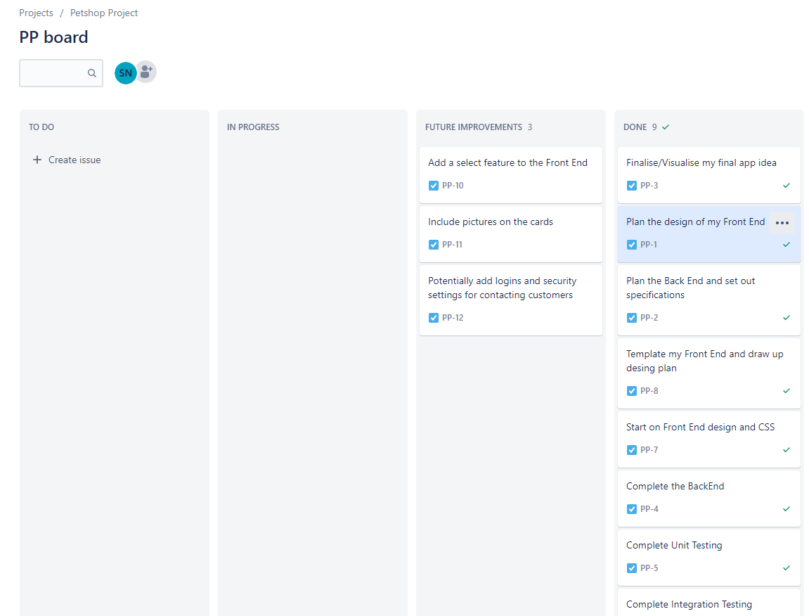
Planning
Jira Board
Simple Planning

Slide 5
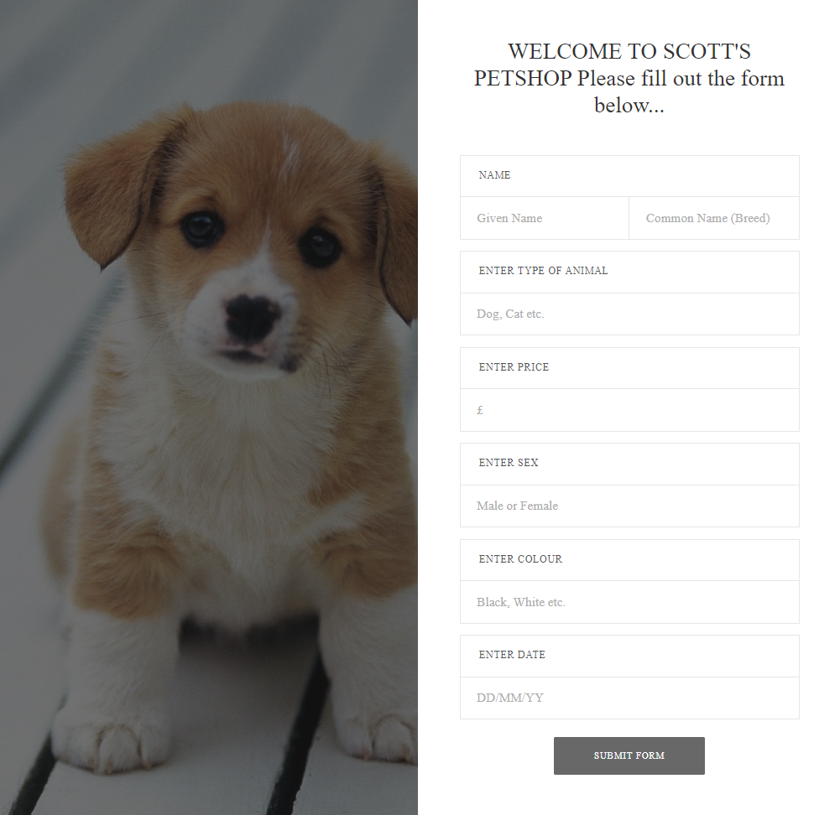
Scott's Petshop App - CREATE
Creates an animal with:
Name + Common Name(Breed)
Type
Price
Sex
Colour
Date

Slide 6
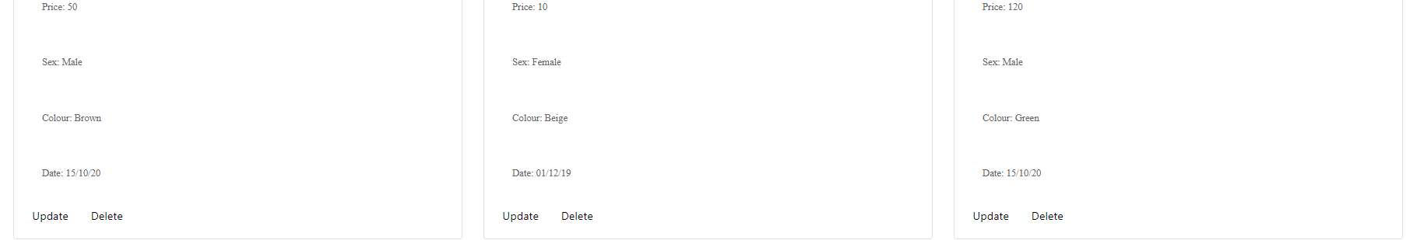
Scott's Petshop App – UPDATE
Update function will show a pop-up window which allows you to change the details listed below. (UPDATE)
Name
Price
Colour
Date ...This is due to the fact breed, type and sec are unlikely to change.

Slide 7
Scott's Petshop App – READ + DELETE
View and updating their animal is done through a card system for simplcity. (READ and UPDATE)
Delete button on each card allowing the user to remove their animal (DELETE)

Slide 8
Front End
HTML
CSS
JS

Slide 9
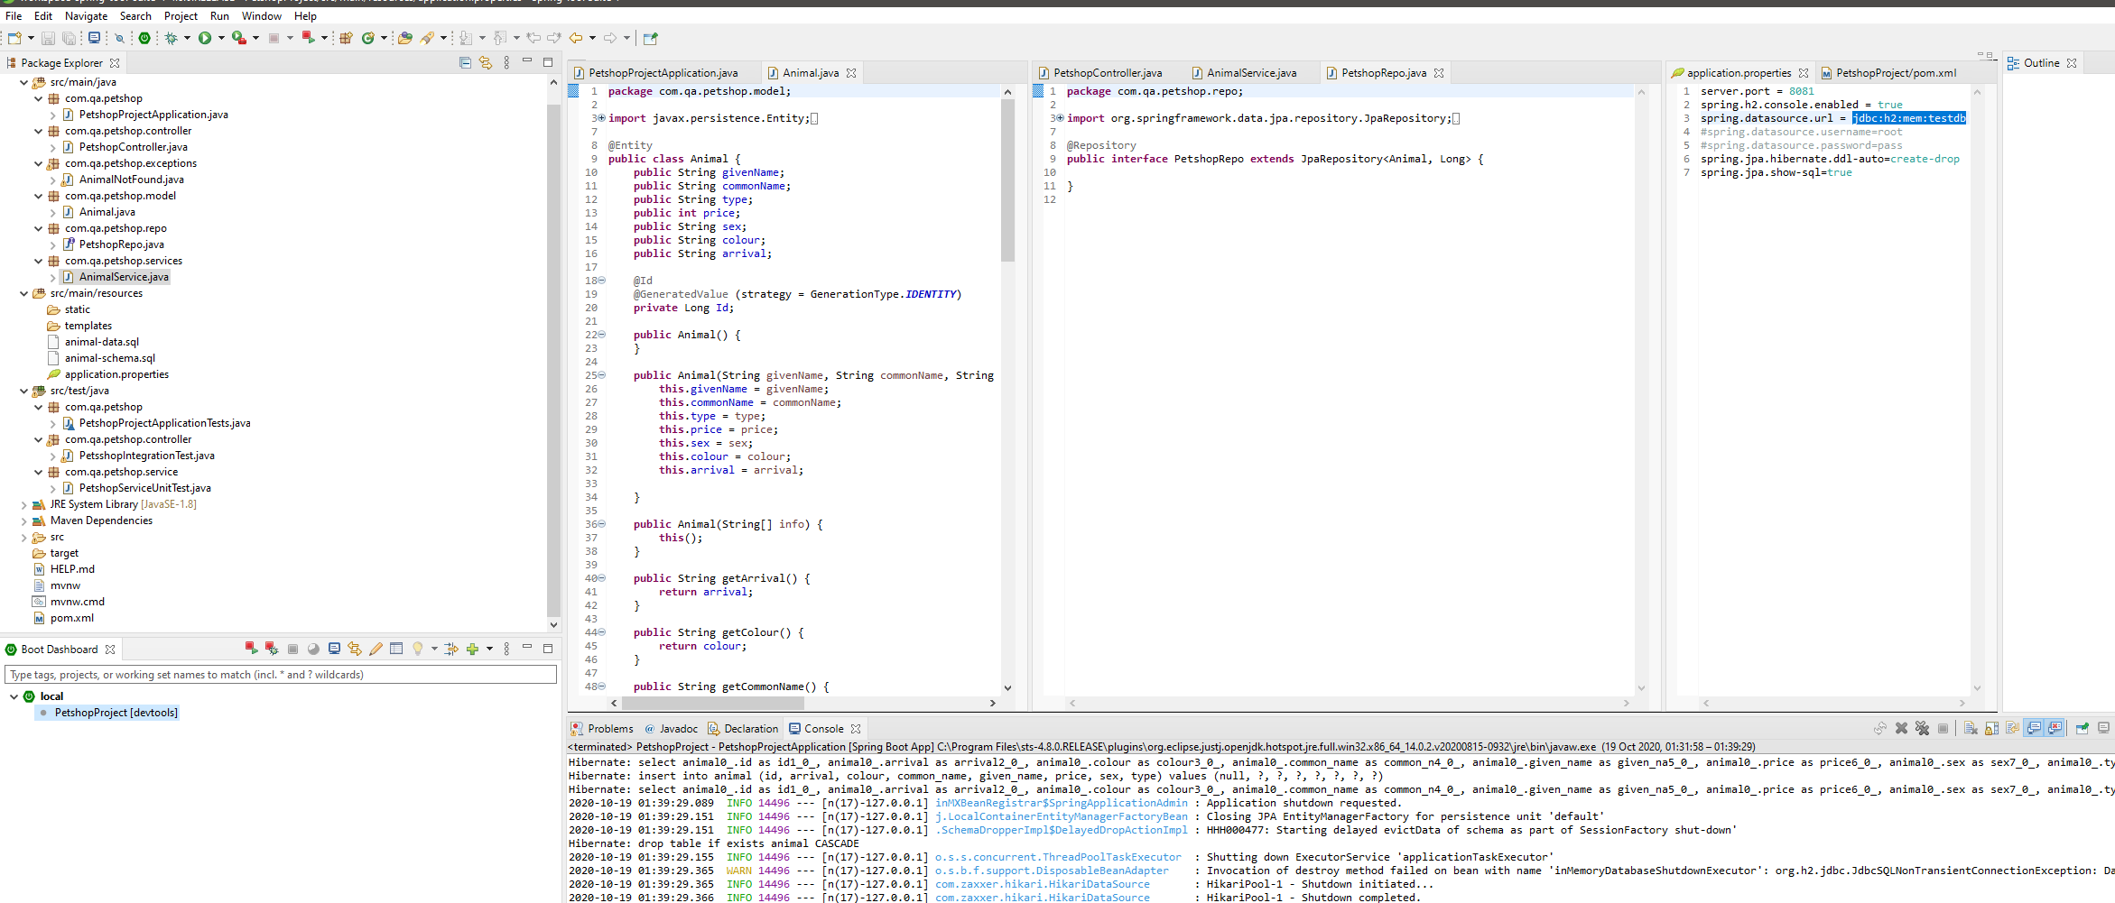
Back End
Java
SpringBoot

Slide 10
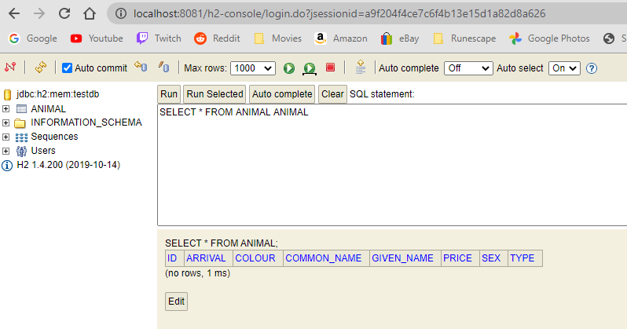
H2 Server
Local server

Slide 11
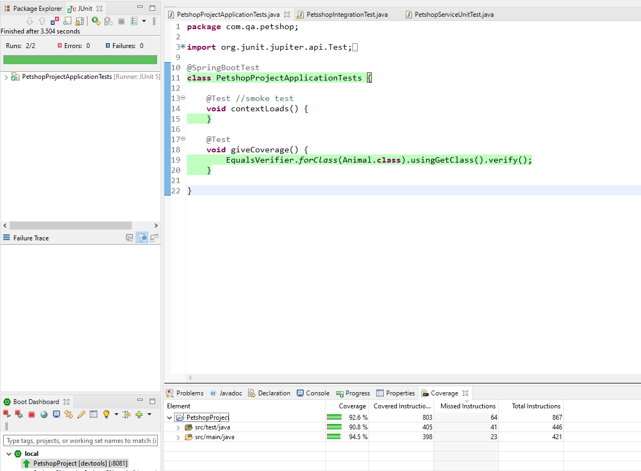
Testing
I ran a total of 10 tests:
2 Application Tests
4 Unit Tests
4 Integration Tests

Slide 12
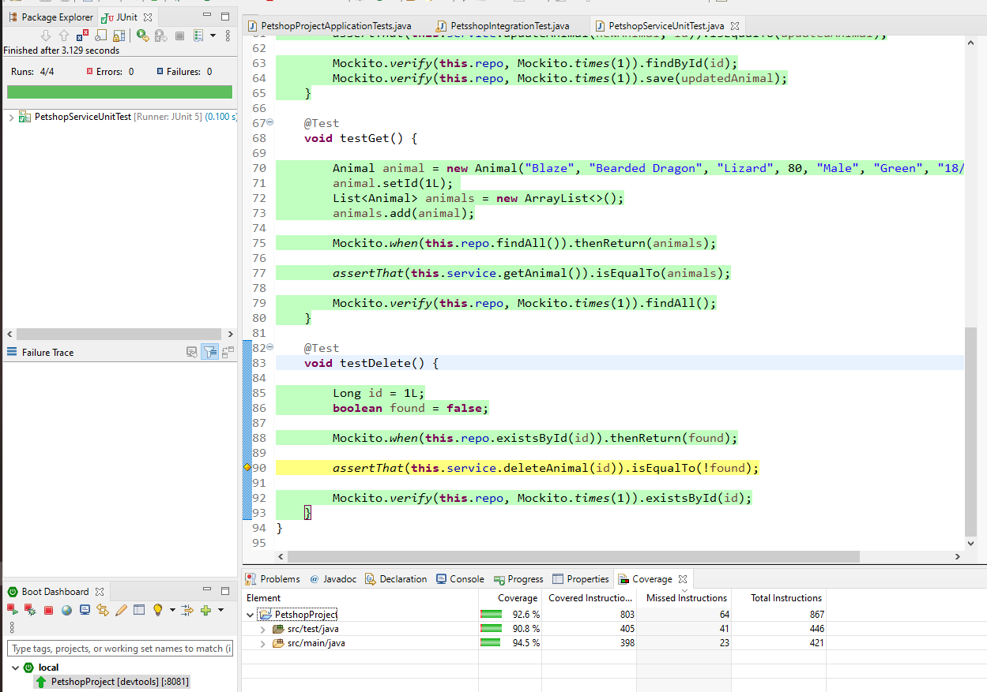
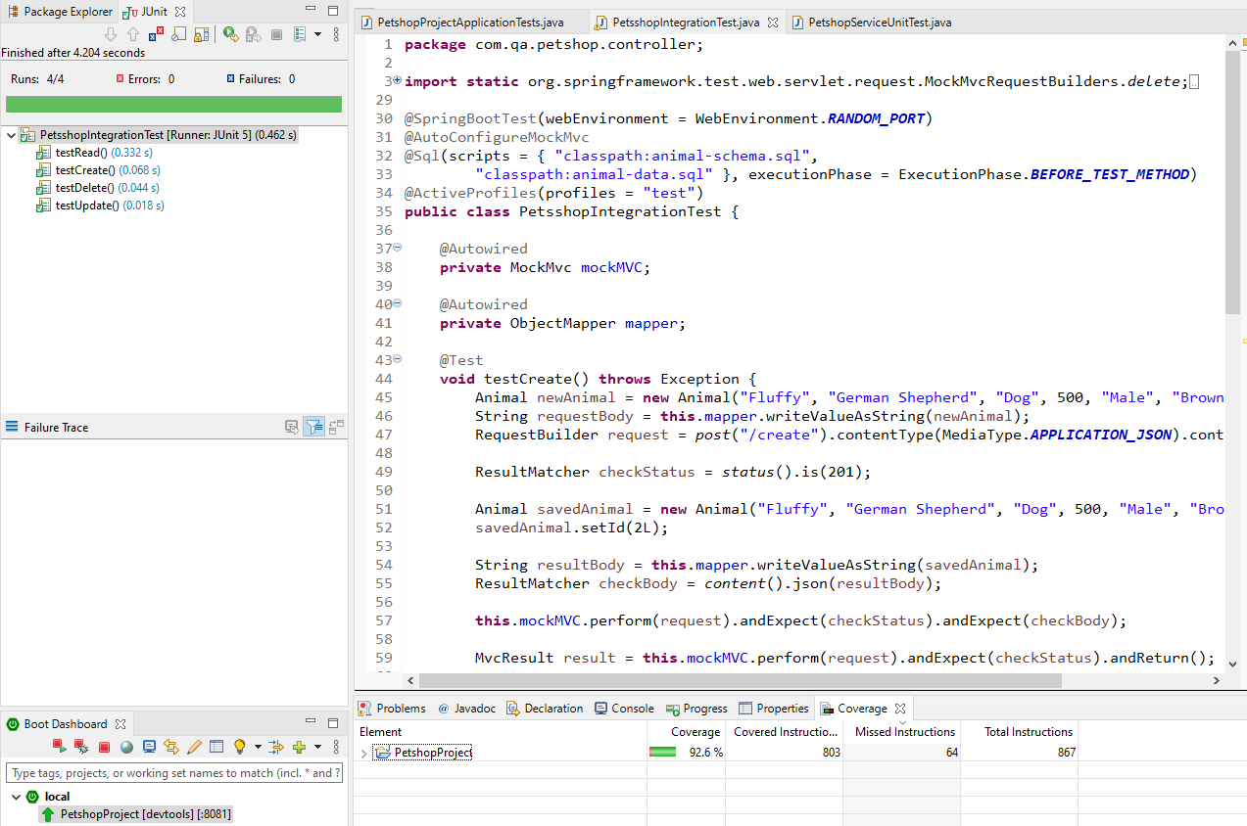
Testing

Slide 13

GitHub
Version Control
Development made so much easier
Helped me enormously with hardware issues
Easy to roll back after any errors

Slide 14
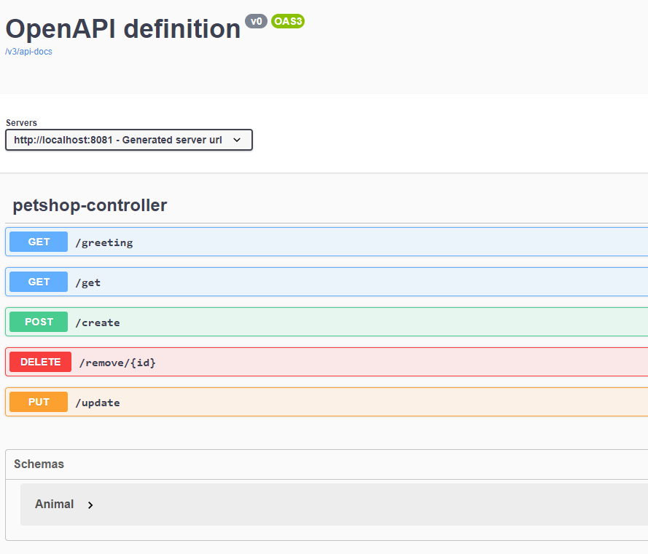

Supporting Tools – Postman, Swagger UI

Slide 15
Issues Encountered
Error Handling
Testing
Back End concepts - Learning

Slide 16
Thank You
Any Questions?

